Slide 1
Determining the best neighborhood in Washington, D.C. to place a new Ethiopian restaurant.

Slide 2
Background
Want to find an optimal location to open a new Ethiopian restaurant in Washington, D.C.
D.C. already has many highly-rated Ethiopian restaurants.
Parking in D.C. can be difficult. Want to place the restaurant near a metro station to increase accessibility.

Slide 3
Data Collection
The data we need to make our decision are:
number of existing Ethiopian restaurants in each neighborhood
location of metro stops
regularly spaced grid of locations, centered around city center, which will be used to define neighborhoods

Slide 4
Data Sources
The following data sources will be needed to extract/generate the required information:
the number of Ethiopian restaurants and their locations in every neighborhood will be obtained using Foursquare API
the location of metro stops will be obtained using the Washington Metropolitan Area Transit Authority API
the coordinates of Washington, DC’s center will be visually approximated; neighborhood centers will be generated algorithmically

Slide 5
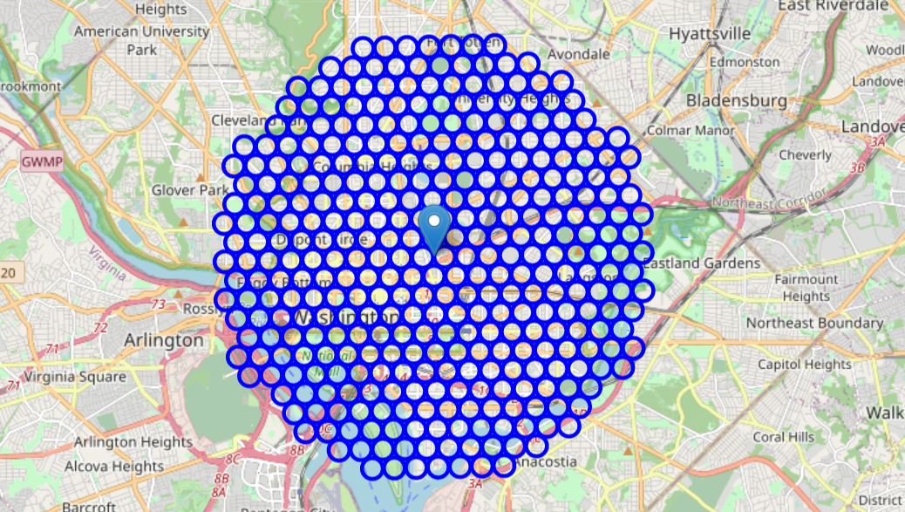
Candidate Neighborhoods

Slide 6
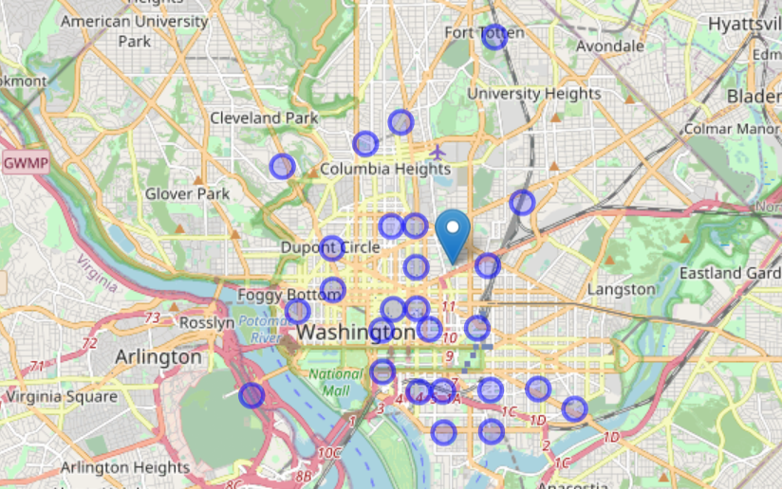
Analysis – Metro Stops
First, we want to make sure a metro stop is in the neighborhood we choose so we know that it is accessible.
26 neighborhoods were found with at least one metro stop.

Slide 7
Analysis – Ethiopian Restaurants
Next, we want to prioritize areas with fewer Ethiopian restaurants.
20 neighborhoods were found that had at least metro stop and no other Ethiopian restaurants (highlighted in purple on the next slide)
3 of these neighborhoods actually had 2 metro stops, meaning they are extra accessible (highlighted in red on the next slide)

Slide 8
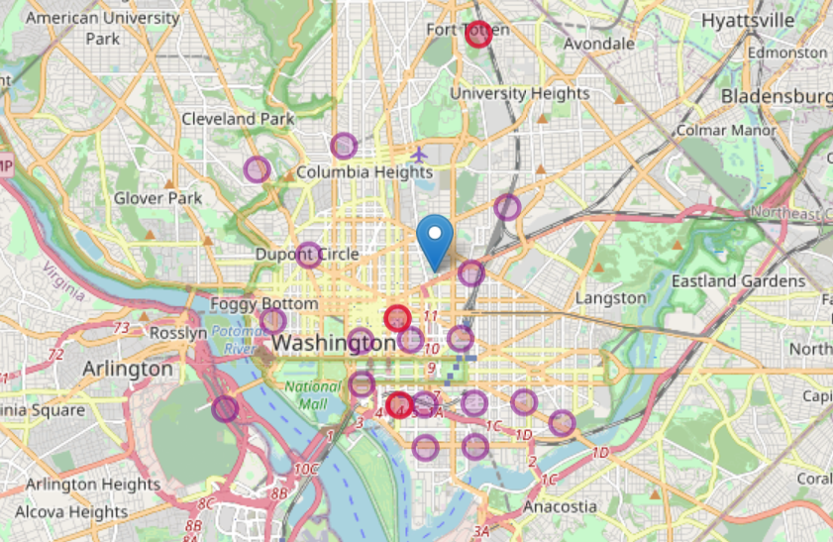
Analysis – Ethiopian Restaurants

Slide 9
Conclusion
Several areas of the city that are accessible and do not have the competition of other Ethiopian restaurants.
Several other factors could affect the desirability of neighborhoods to visit and eat in.
These candidate neighborhoods should be explored further by the stakeholder to determine the best location.

